Slide 1
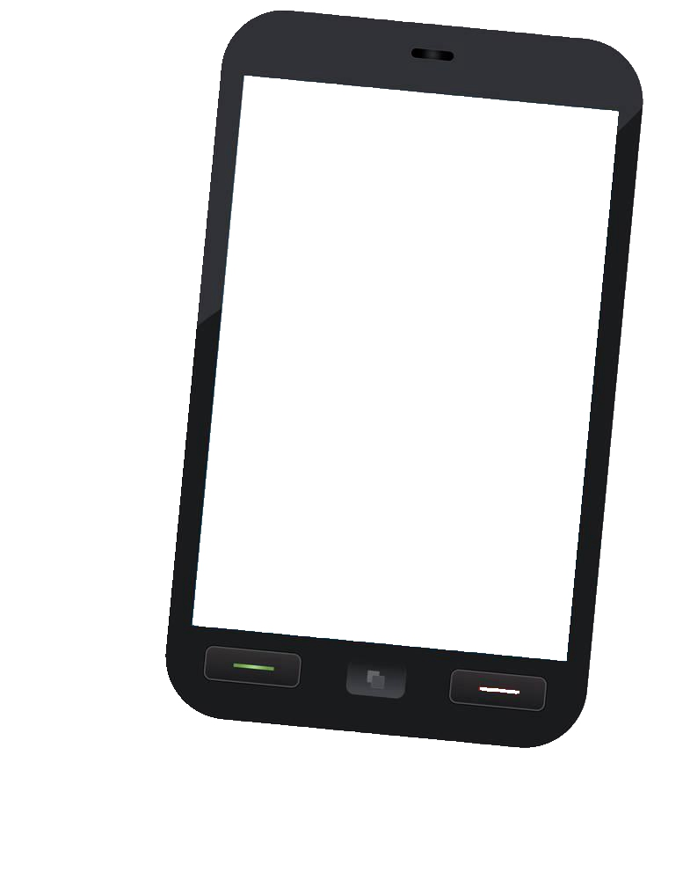

Life & Work Helper

Slide 2

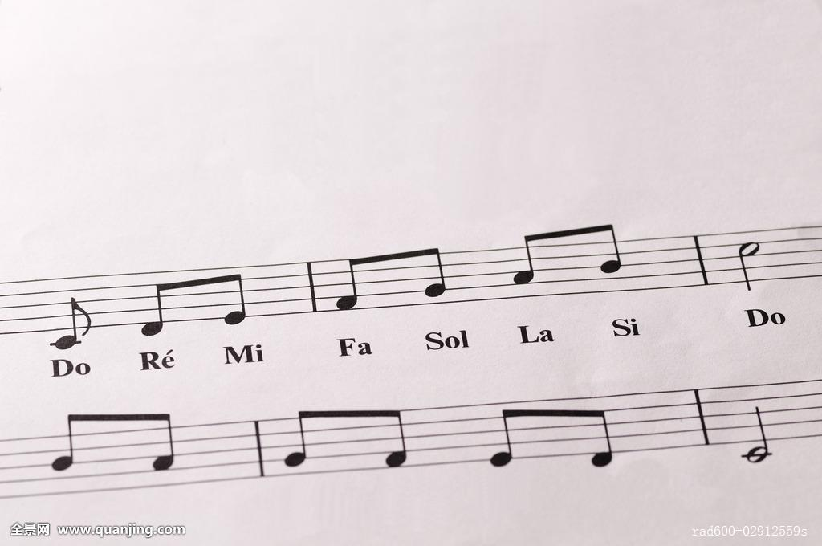

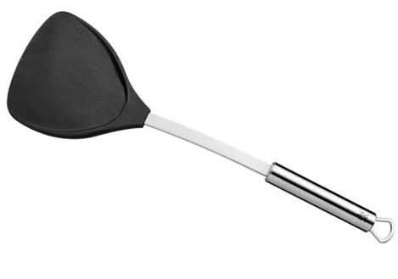

We give tips when user click into this feature, the tips content would change base on user classification and time period.
Life & Work Helper
what should I do now?

Slide 3

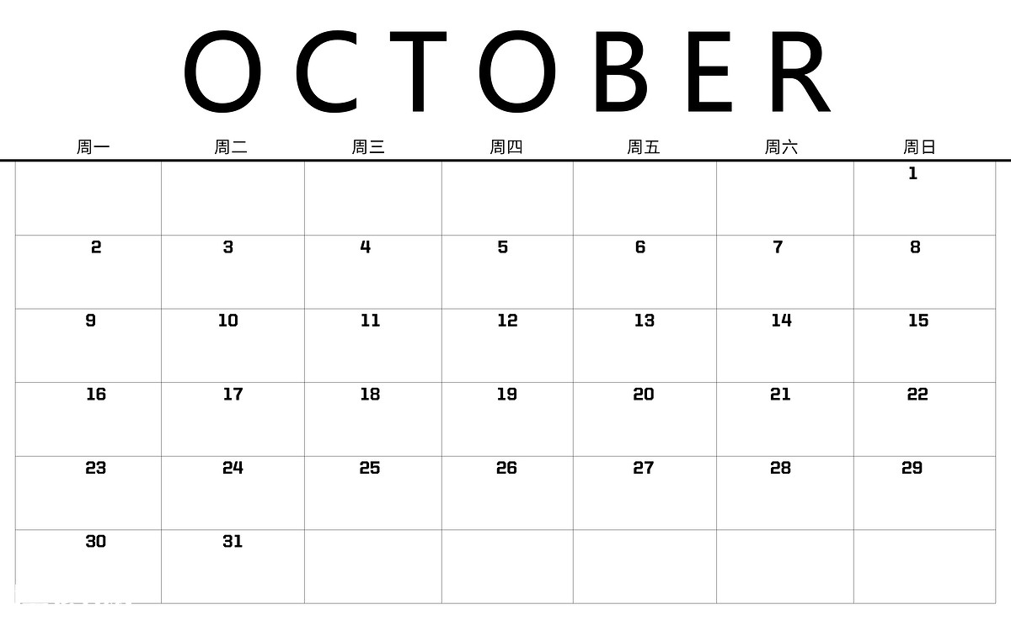






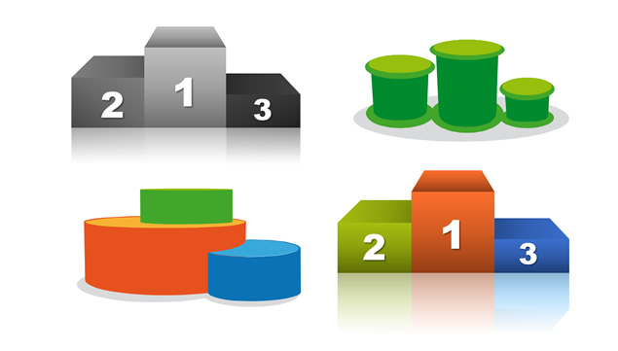

Give key words ansers to user to choose, base on the key words to classify user.
Tips firstly comes from HSBC internal activities and lesson, and outside websites. Secondly tips would refer to user history data as well.
User could choose to join or watch the tips.
After tips completing, user would get bonus points.
There would be the charts for bonus points.
Bonus points could be used to create activities, join trade union activites in higher priority,and recognize others.

Slide 4

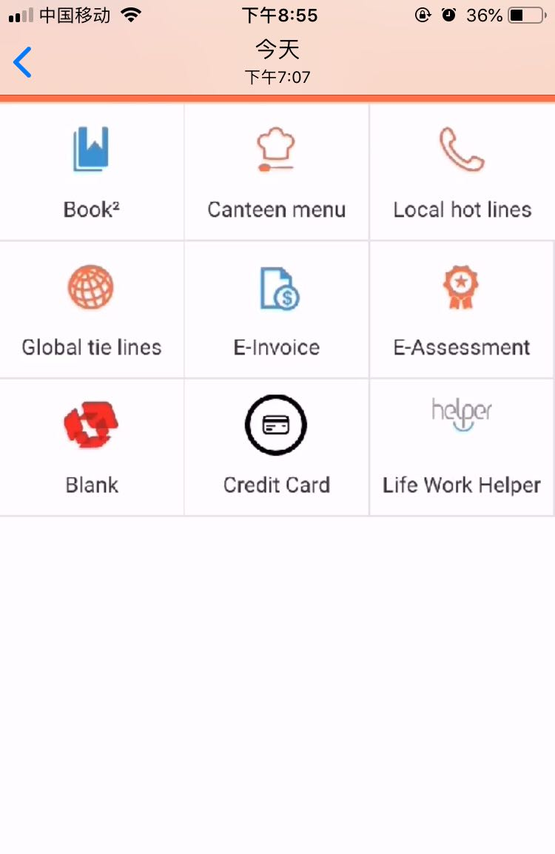
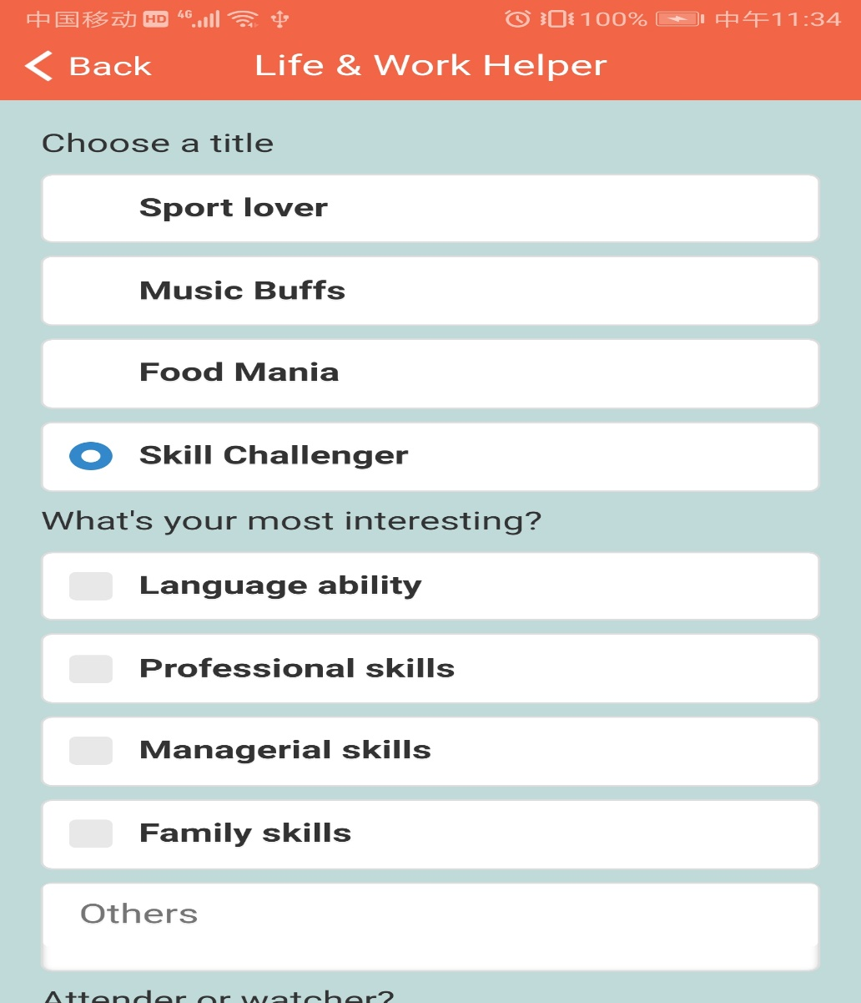
Demo

Slide 5
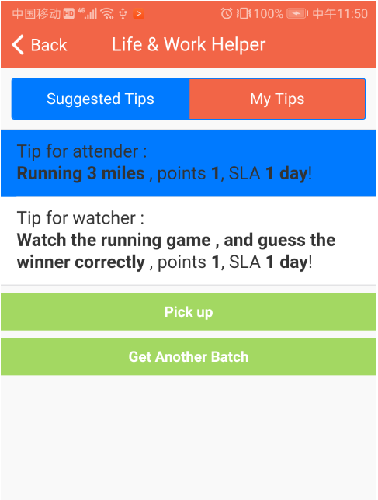
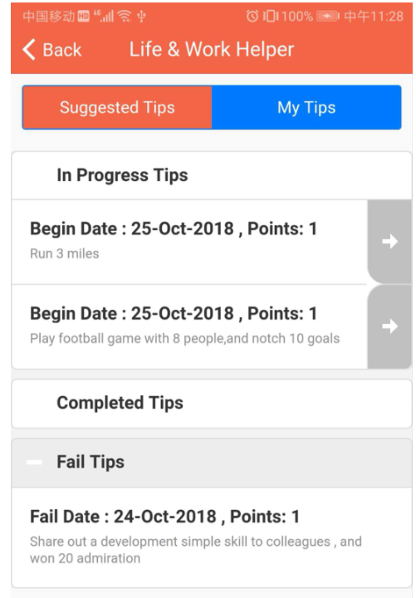
Get tips and pick up

Slide 6
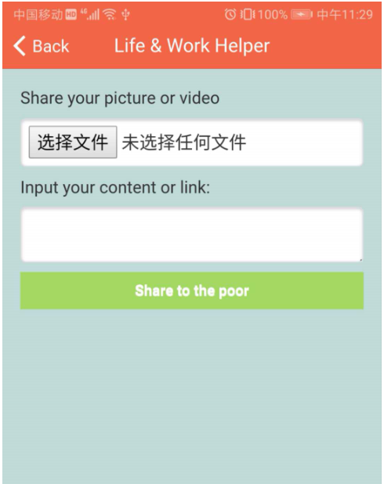
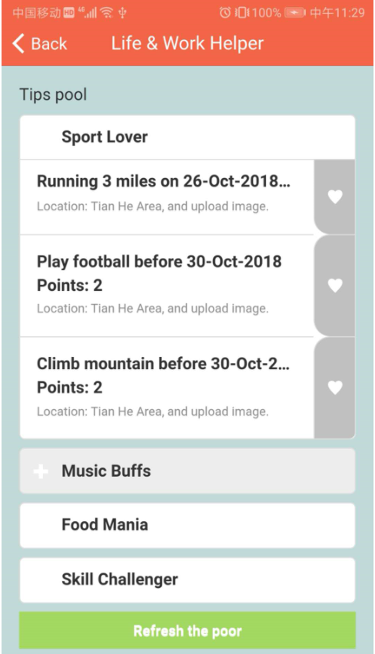
Complete tip to Get points

Slide 7
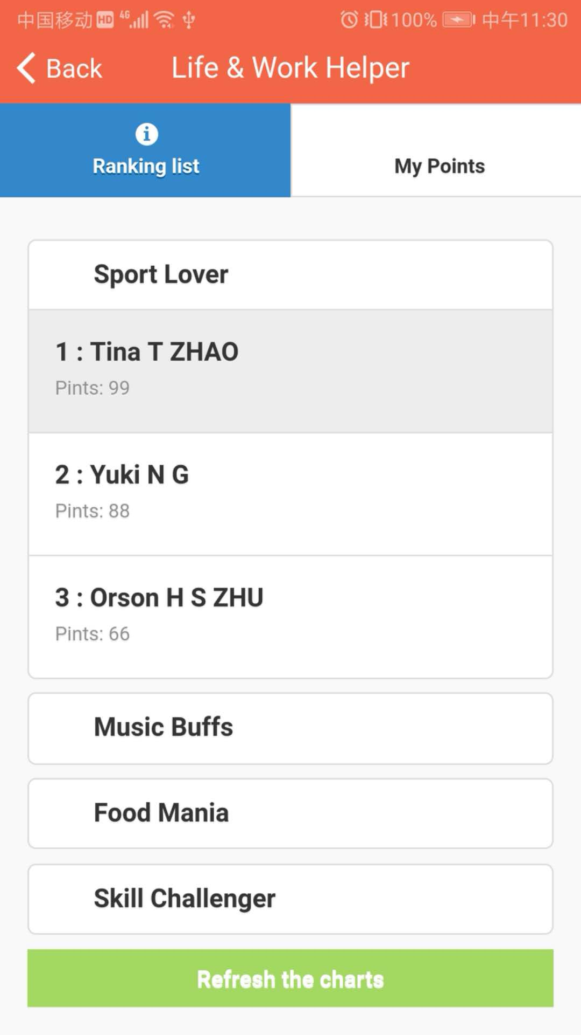
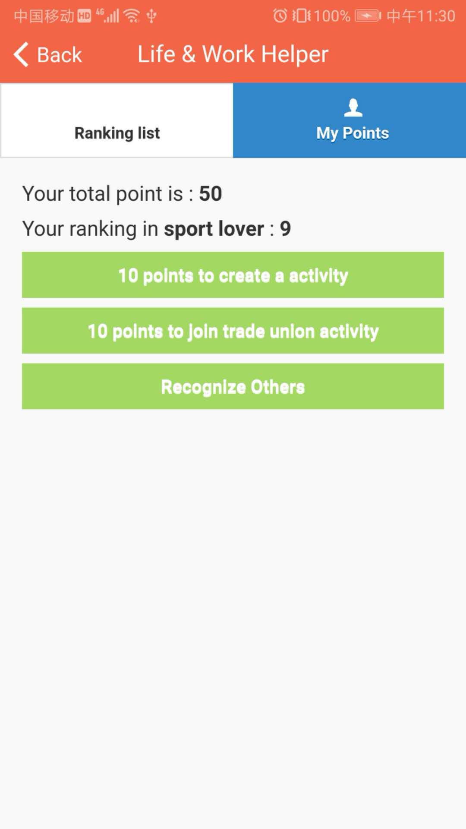
Use Points

Slide 8
Thank You

